Slide 1

Data Description
Session 8
Mercedeh ERFANIANGHASAB Jérémy CELSE
Mercedeh.ERFANIANGHASAB@essca.fr | jeremy.celse@essca.fr

Slide 2
Exercise 1
Temperature | Frequency
-1 | 20%
0 | 17%
2 | 43%
3 | 10%
7 | 10%
We studied the morning temperature (i.e. measured between 7am and 7.30am) over 200 days chosen randomly from the winter periods observed over the last 20 years.
The data are represented in the following table:
Calculate the Pearson coefficient
Calculate the Yule and Kendall coefficient

Slide 3


Exercise 1 - Solution
Temperature | Number of days | $$f_{i}$$
-1 | 40 | 20%
0 | 34 | 17%
2 | 86 | 43%
3 | 20 | 10%
7 | 20 | 10%
Total | 200 | 100%
$\overline{x}=1.66$
$s=2.228093$
$Mode=2$
Coefficient of Pearson = $\frac{1.66 −2}{2.228093 } =−0.1525969 < 0$

Slide 4
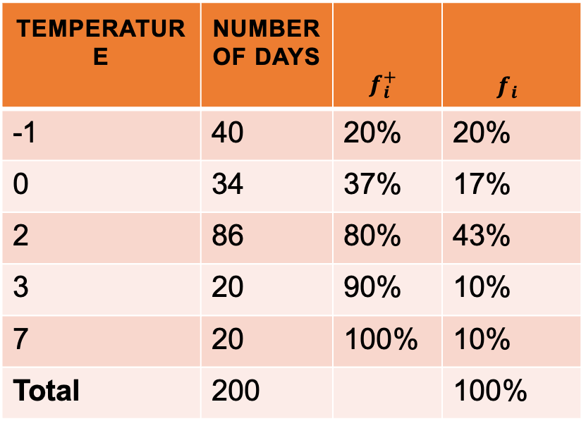

Exercise 1 - Solution
$q_{1}=0$
$q_{2}=median=2$
$q_{3}=2$
Coefficient of Yule & Kendall = $\frac{\left(2 −2\right) −(2 −0)}{(2 −0)}=−1<0$
Temperature | Number of days | $$f_{i}^{+}$$ | $$f_{i}$$
-1 | 40 | 20% | 20%
0 | 34 | 37% | 17%
2 | 86 | 80% | 43%
3 | 20 | 90% | 10%
7 | 20 | 100% | 10%
Total | 200 |  | 100%

Slide 5
Exercise 2
We studied the morning speed (i.e. measured (in Km/h) between 7am and 7.30am) of the wind over 240 days chosen randomly from the winter periods observed over the last 20 years.
The data are represented in the following table:
Calculate the Pearson coefficient
Calculate the Yule and Kendall coefficient
Speed | Number of days
[0 ; 10] | 42
[10 ; 30] | 48
[30 ; 70] | 90
[70 ; 100] | 24
[100 ; 150] | 36

Slide 6
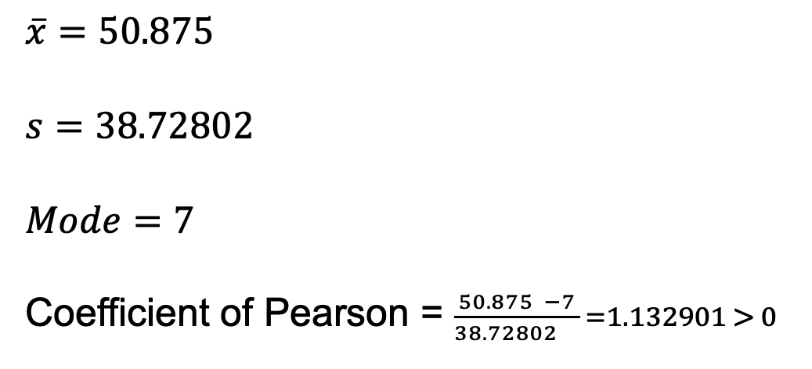
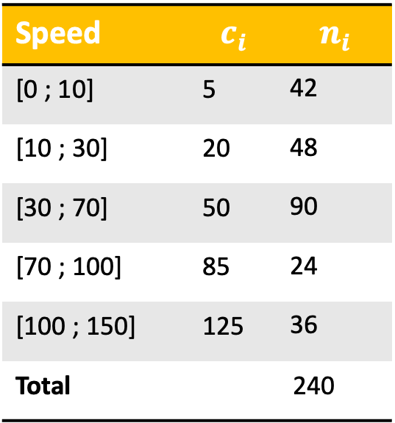
Exercise 2 Solution
Speed | $$c_{i}$$ | $$n_{i}$$
[0 ; 10] | 5 | 42
[10 ; 30] | 20 | 48
[30 ; 70] | 50 | 90
[70 ; 100] | 85 | 24
[100 ; 150] | 125 | 36
Total |  | 240
$$\overline{x}=50.875$$
$s=38.72802$
$$Mode=7$$
Coefficient of Pearson = $\frac{50.875 −7}{38.72802 } =1.132901 > 0$

Slide 7
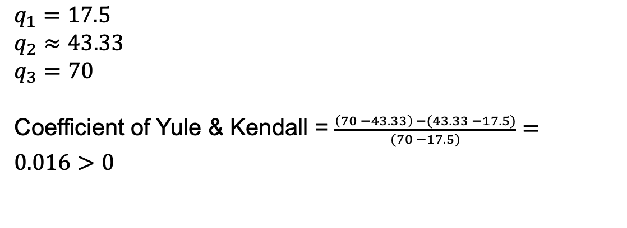
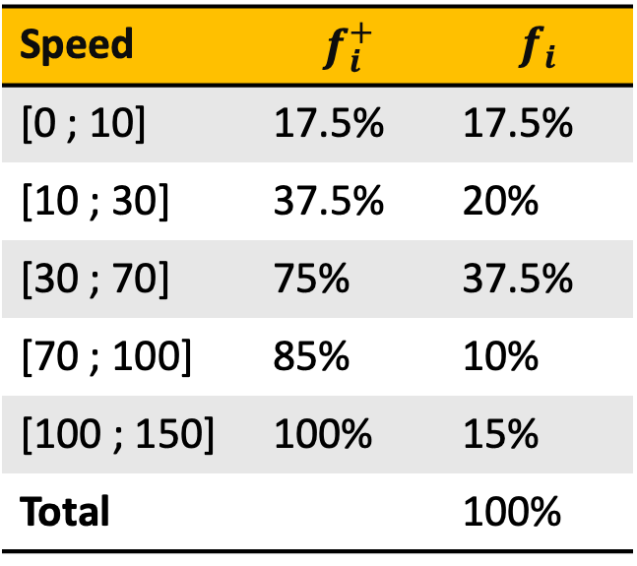
Exercise 2 Solution
Speed | $$f_{i}^{+}$$ | $$f_{i}$$
[0 ; 10] | 17.5% | 17.5%
[10 ; 30] | 37.5% | 20%
[30 ; 70] | 75% | 37.5%
[70 ; 100] | 85% | 10%
[100 ; 150] | 100% | 15%
Total |  | 100%
$$q_{1}=17.5$$
$$q_{2}≈43.33$$
$$q_{3}=70$$
Coefficient of Yule & Kendall = $\frac{\left(70 −43.33\right) −(43.33 −17.5)}{(70 −17.5)}=0.016>0$

